Slide 1
Today's themes
Intelligent systems- Motivation
Internet of Things
  Sensors, Actuators, Controllers

Slide 2
Intelligent Systems

Slide 3


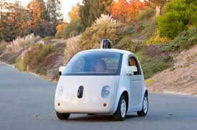



What are intelligent systems?
Artificial Intelligence is impacting the automotive industry.
Driving:
Driver assist
Driverless Automobiles
Goal: Safety
Car Manufacturing:
Robots are driving optimization and the rethinking of processes and production in innovative new ways.
Cloud Services:
Predictive Maintenance
Individualized Marketing
Goal: Data
Driver Monitoring:
Detecting driver behavior- identification, recognition, monitoring and control.
Google, Tesla, and Toyota- Investment in intelligent systems
How self-driving cars work- An example from Googles self-driving cars
However, artificial intelligence is very much more than the car industry!
Car Insurance:
Speeds up the process of filing claims when accidents do occur.
Source: https://igniteoutsourcing.com/automotive/artificial-intelligence-in-automotive-industry/

Slide 4
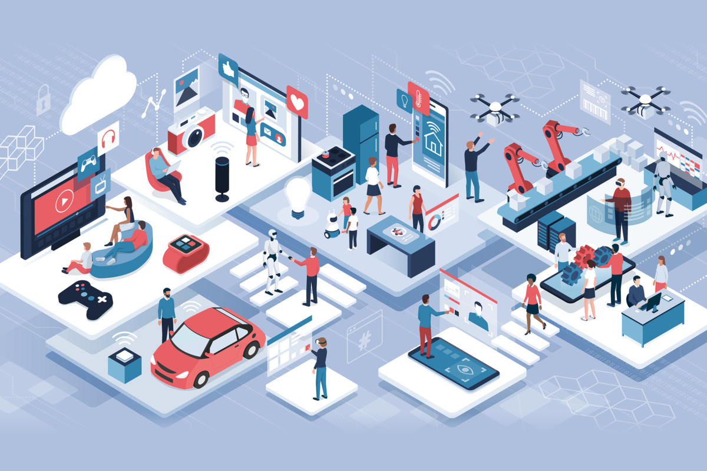
Intelligent systems …
Internet of Things (IoT).
  Beacon technology
  Near Field Communication (NFC)
  Radio-Frequency Identification (RFID)
  Sensors

Slide 5
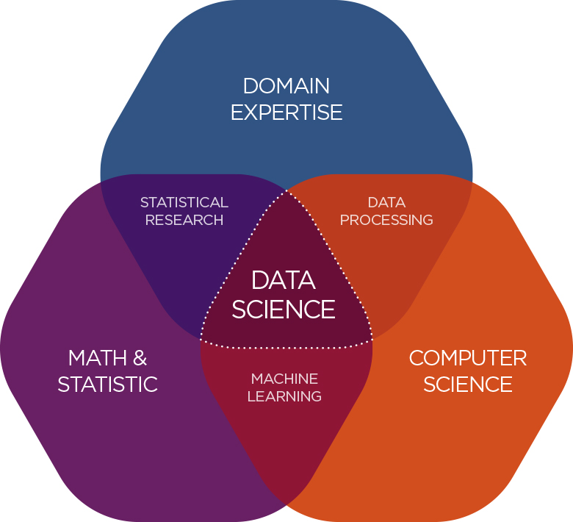
Intelligent systems …
Data Science:
  Big data, analysis … data scientist
  Job of the 21st Century!

Slide 6
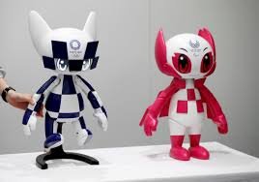
Intelligent systems …
Robots work using artificial intelligence. For example:
  US Boston Dynamics- BigDog, WildCat, Atlas
  Tokyo Olympic Games- 2020

Slide 7
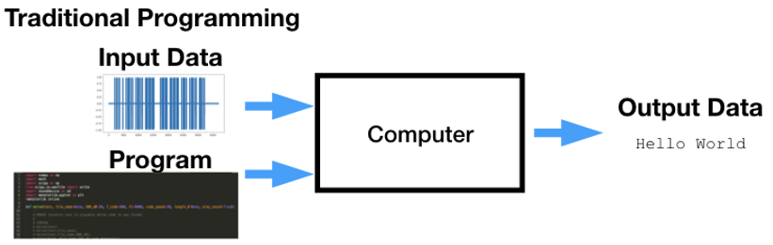
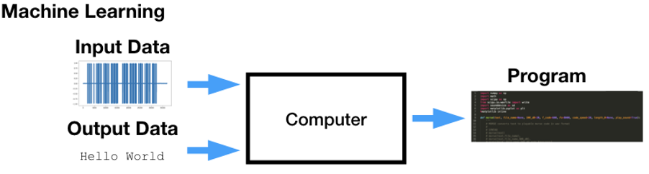
Intelligent systems …
Machine learning
  Traditionally, computers solve problems by being told how to solve it.
  AI is about developing systems that learn from their own experiences and solve complex problems in different situations and environments.
  Machine learning is an algorithm that learns itself to solve problem. Often this happens by finding patterns in large amounts of data.
  In this way, machines will be more similar to humans – like automated processes – e.g. self-driving cars.

Slide 8
Internet of Things

Slide 9
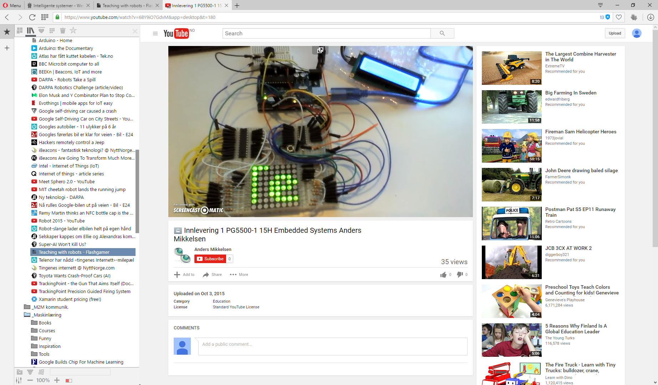
IoT- Internet of Things
Theory of the Internet of Things (IoT) is a large part of this course.
Next courses will allow you build solution- embedded systems, and machine to machine communication.

Slide 10
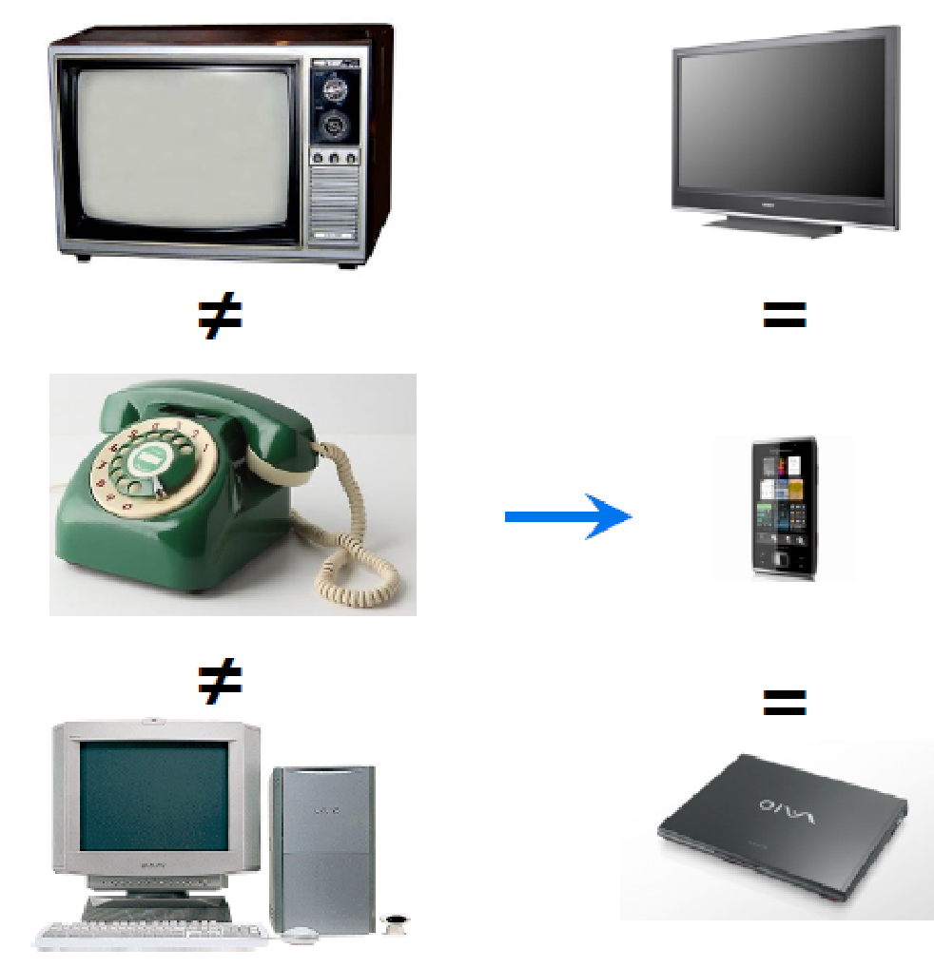
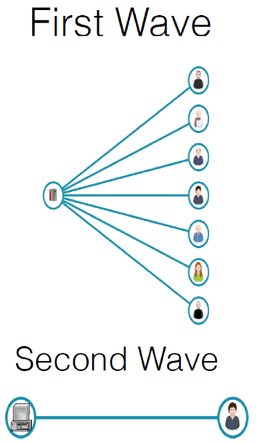
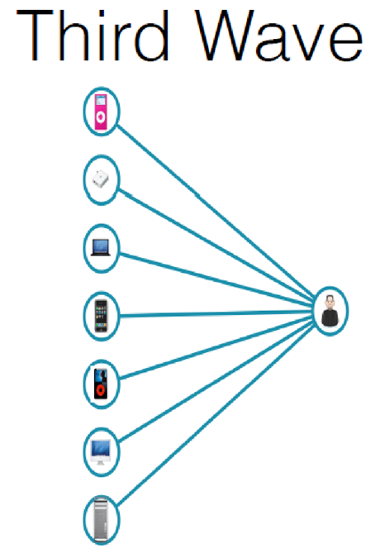
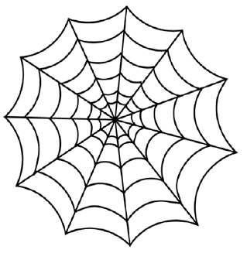
IoT- Computing in the 21st

Slide 11
IoT- Computing in the 21st
Computing in the 21st century will become a ubiquitous service resource that will weave itself into the fabric of everyday life.
… the idea of a personal computer itself is misplaced and that the vision of laptop machines is only a transitional step …
(Weiser, 1991)

Slide 12
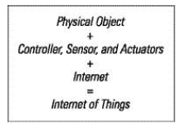
IoT- Sensor, Actuator, Controller
What are sensors, actuators and controllers?
  Sensor- receives real-world input.
  Actuator- Provides feedback to the real world.
  Controller- The data device that controls it all.

Slide 13
Why IoT?
There are several reasons for the development of IoT:
  Hardware prices have fallen- so low that manufacturers do not see financial problems in using microchips in everything from washing machines to cars.
  Like in prices, the physical size has decreased and made it easier to place data power in other machines.
  Prices of broadband services are so low that "everyone" can afford it.

Slide 14
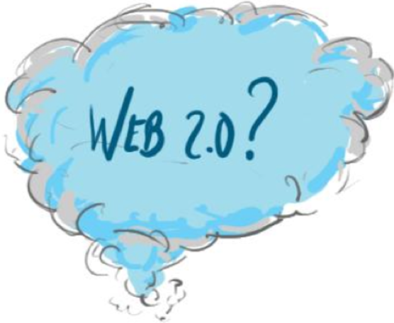
Why IoT?
Apps and modern web standards have made it much easier to build the required client and backend software.
In addition, exchange of data/information has become so large that one can see as growing market for this type of hardware.

Slide 15
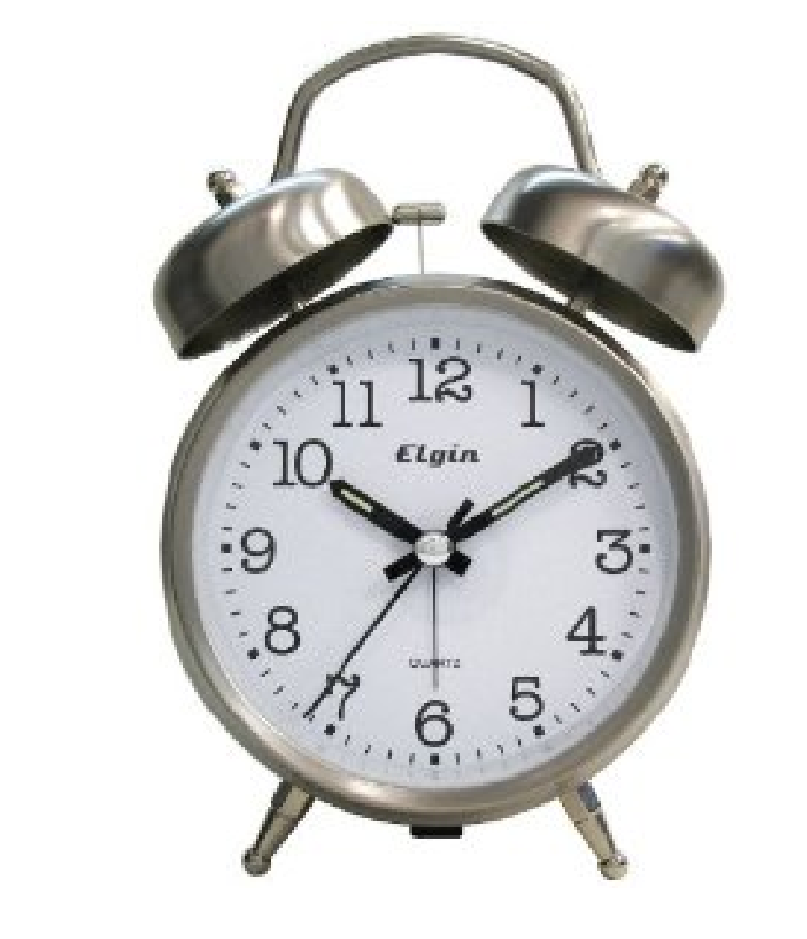
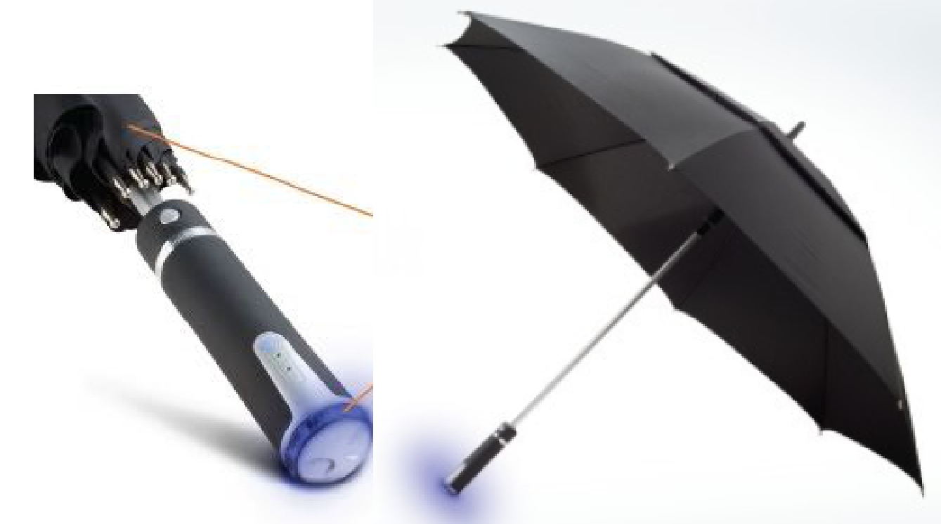
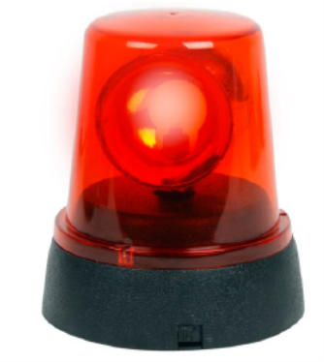
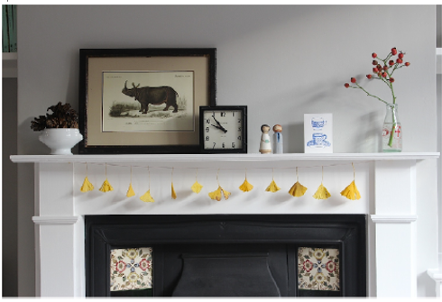
Clock notices delayed train
Weather forecast enabled umbrella
blinking light reminds you it’s time to take your tablets
mantelpiece at home: an ornament with dial notices

Slide 16
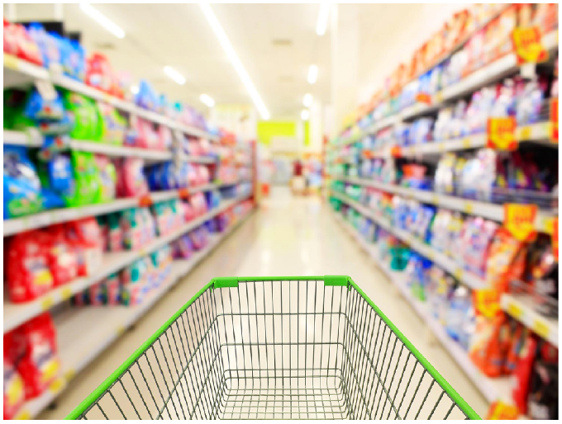
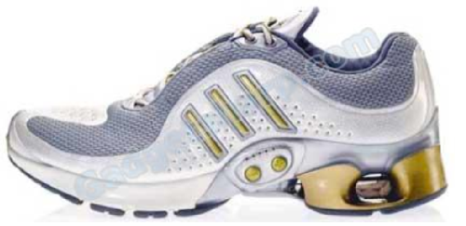
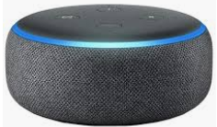
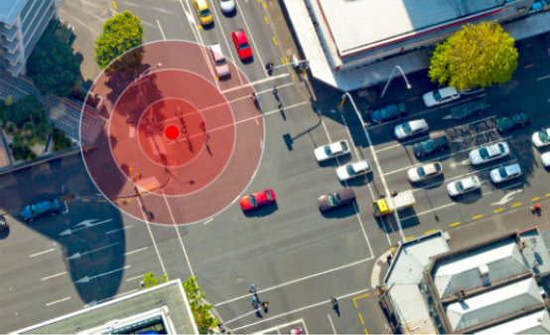
In shops
Shoe pedometer
Smart speakers
LCD display at a bus stop- expected time vs real-time

Slide 17
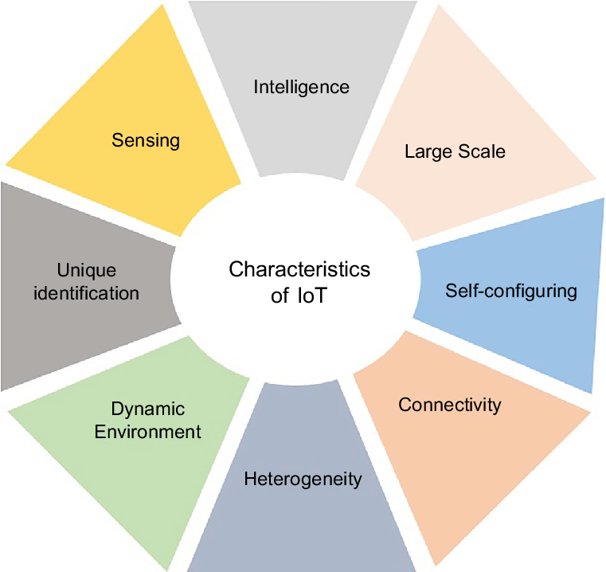
IoT characteristics

Slide 18
A Thing?
A laptop takes 90% attention, a smartphone 40%, "classic" phone 20%, and IoT should take max 0-5% (Intel, 2015)
Calm technologies- don’t compete for attention yet are ready to provide utility … when we decide to give them some attention (Mark Weiser).
In IoT, there is no standard, proven, manufacturer independent way to implement a complete app for manipulating data from a custom IoT system.

Slide 19
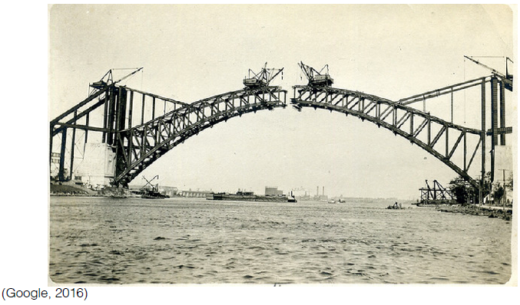
A Thing …
bridge status monitoring
Notes:
https://blog.bosch-si.com/smart-city/connected-infrastructure-how-iot-enables-bridge-health-monitoring/

Slide 20
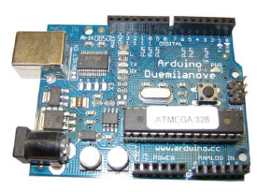
Web of Things
The Internet of Things is the foundation.
Application layer vs network layer.
Standards through HTTP and the web services.
An ecosystem for exposing smart objects / devices.

Slide 21
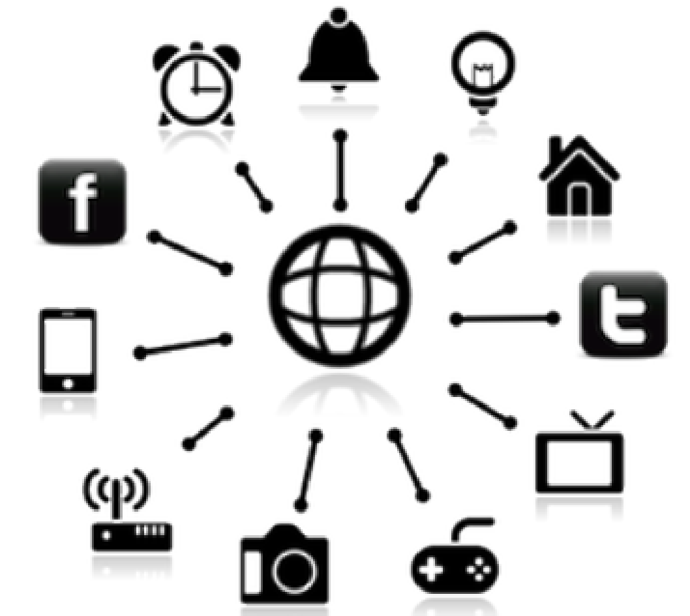
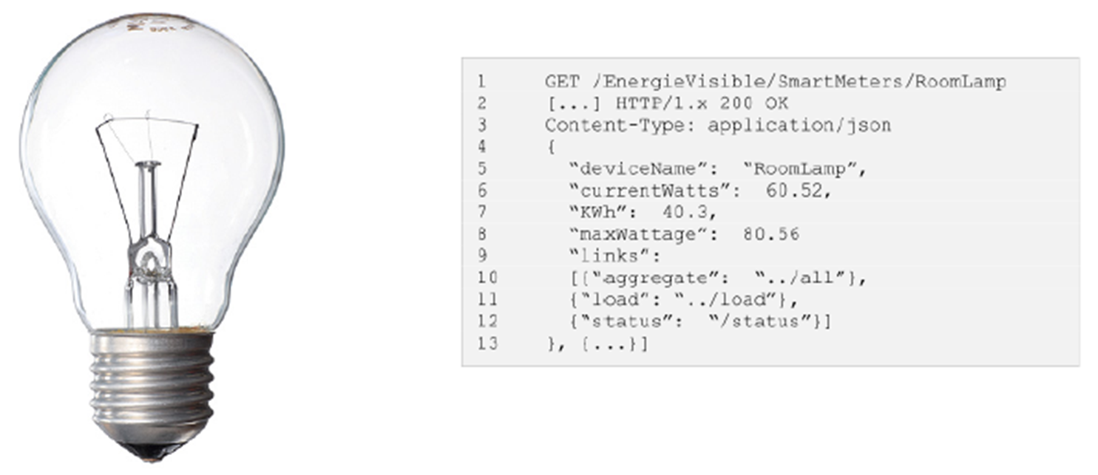
Web of Things …
Exposure of real-time data
Vertical architecture- all communication layers
Integrated as part of the web
JSON for WoT

Slide 22
Web of Things …
Challenges in communication:
  Prevalence and adoption
  Synchronization of distributed data
  Full part of the web

Slide 23
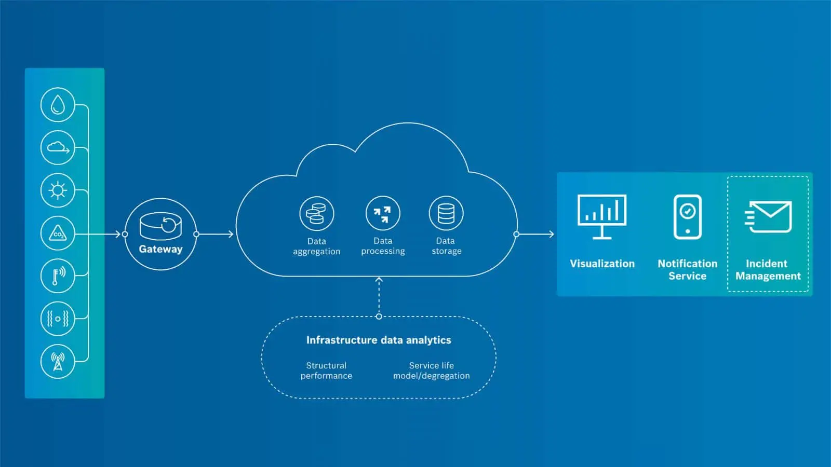
Web of Things …
Notes:
https://blog.bosch-si.com/smart-city/connected-infrastructure-how-iot-enables-bridge-health-monitoring/

Slide 24
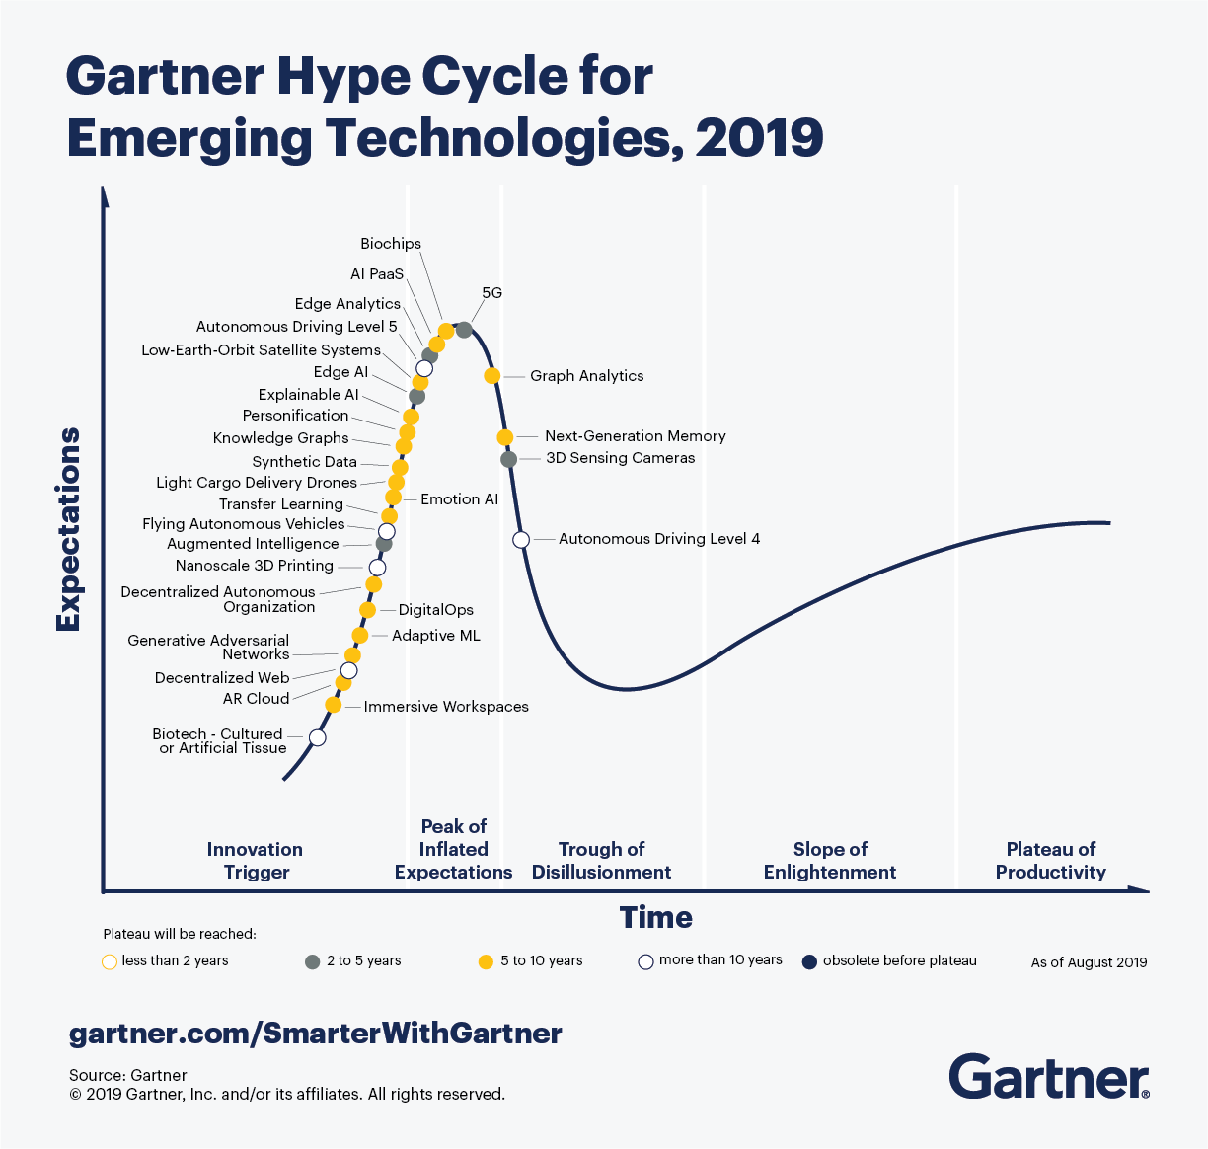
Web of Things …
What is it?
Notes:
Autonomous Driving Level 5:
Level 0 - No Automation. This describes your everyday car. ...
Level 1 - Driver Assistance. Here we can find your adaptive cruise control and lane keep assist to help with driving fatigue. ...
Level 2 - Partial Automation. ...
Level 3 - Conditional Automation. ...
Level 4 - High Automation. ...
Level 5 - Full Automation.
https://www.truecar.com/blog/5-levels-autonomous-vehicles/

Slide 25
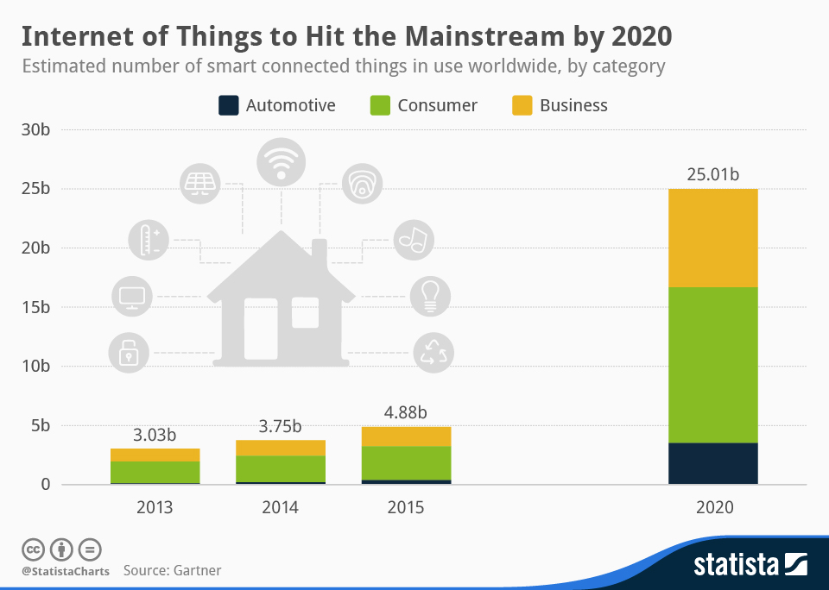

Slide 26
Mentimeter discussion points
What is Intelligent Systems? Any suggestions from you ...
Using so much technology has also a downside. What challenges do you see in Intelligent Systems?
Select the discipline (s) that you understand better or you are most familiar with- AI, Intelligent Systems, IoT, Robotics, Data Science
Select example (s) of Intelligent Systems in a smart house- bulb, speaker, fridge

Slide 27
Next time
Today's exercises:
  Tasks related to intelligent systems in general.
  Tasks related to the Internet of Things.
Main topics:
  Artificial intelligence: Agents & finite state machines.
  IoT: Design principles for connected devices.

